Slide 1
 | No Shielding | With Shielding (0 depth) | With Shielding (3 cm depth)
No B field | 581 +/- 35
5 Gauss | T: 587 A: 558 | T: 585 A: 573 | T: 610 A: 614
10 Gauss | T: 600 A: 423 | T: 600 A: 470 | T: 609 A: 586
15 Gauss | T: 563 A: 272 | T: 588 A: 338 | T: 590 A: 594
20 Gauss | T: 509 A: 203 | T: 573 A: 235 | T: 570 A: 568
25 Gauss | T: 295 A: 156 | T: 594 A: 176 | T: 636 A: 526
30 Gauss | T: 59 A: 110 | T: 587 A: 129 | T: 604 A: 531

Slide 2
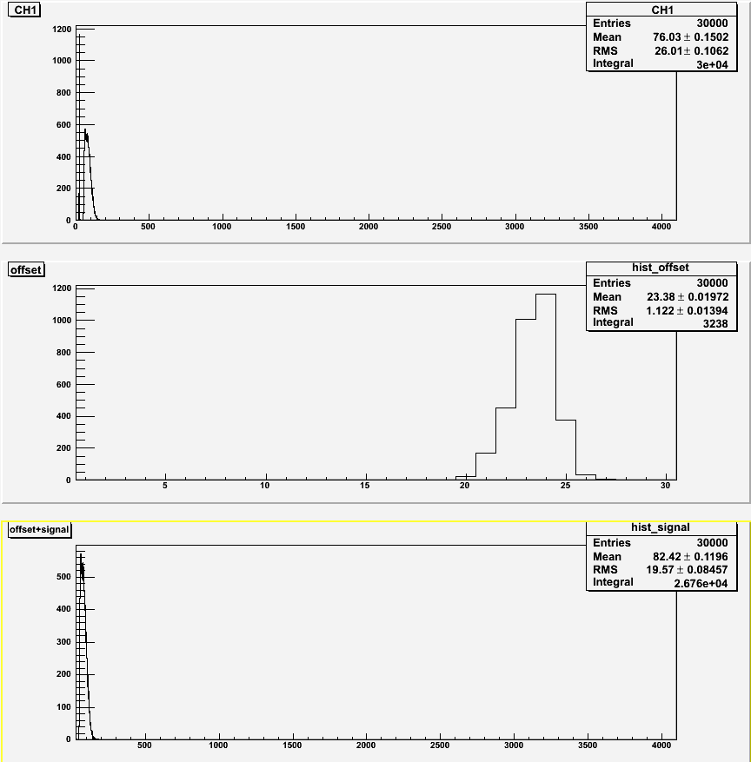
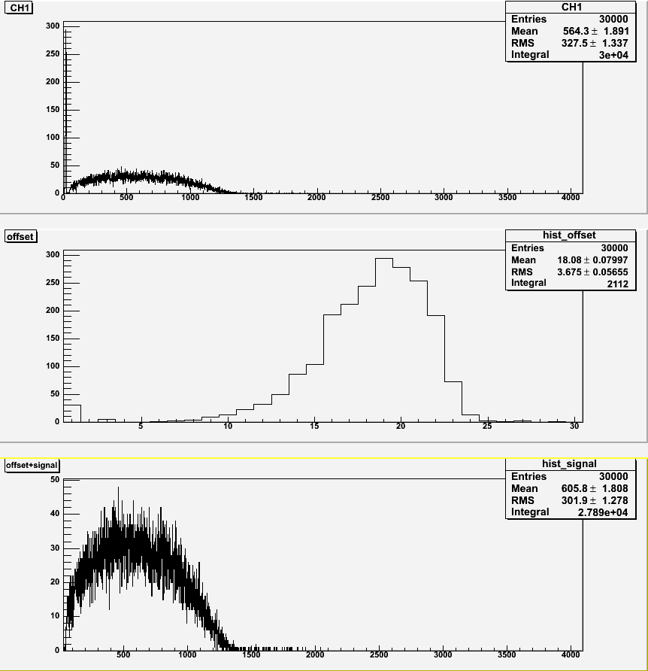
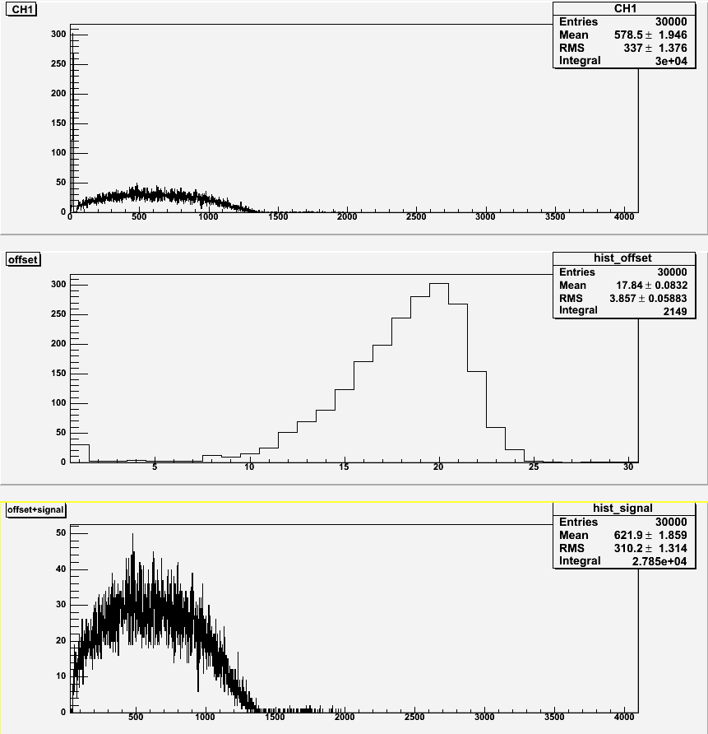
30 Gauss Transverse
No shielding
With shielding (0)
With shielding (3)

Slide 3
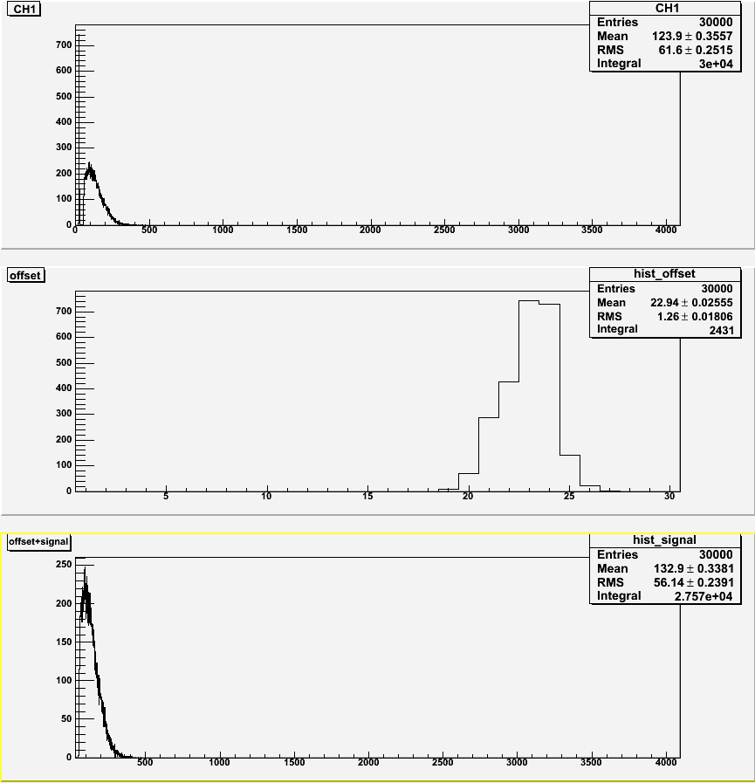
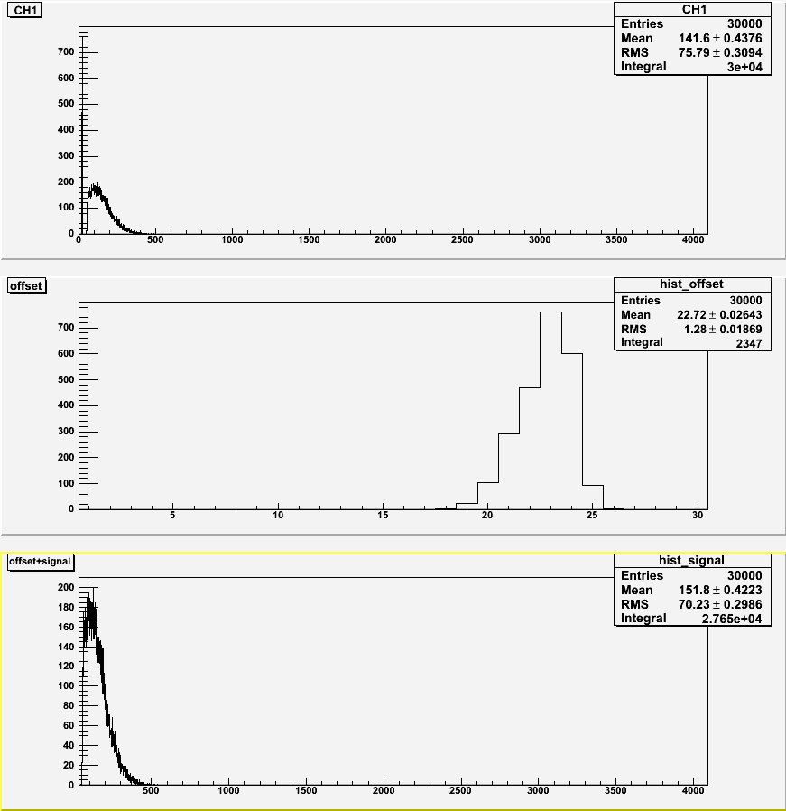
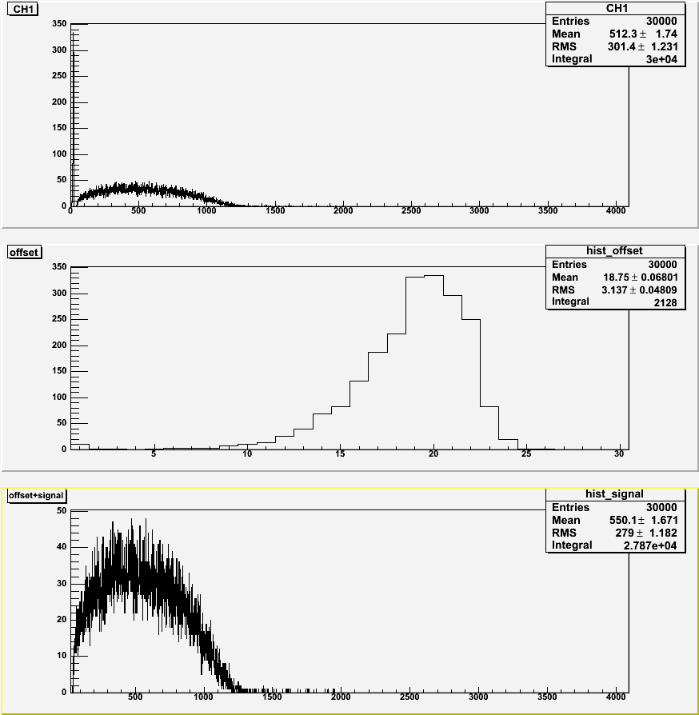
30 Gauss Axial
No shielding
With shielding (0)
With shielding (3)

Slide 4
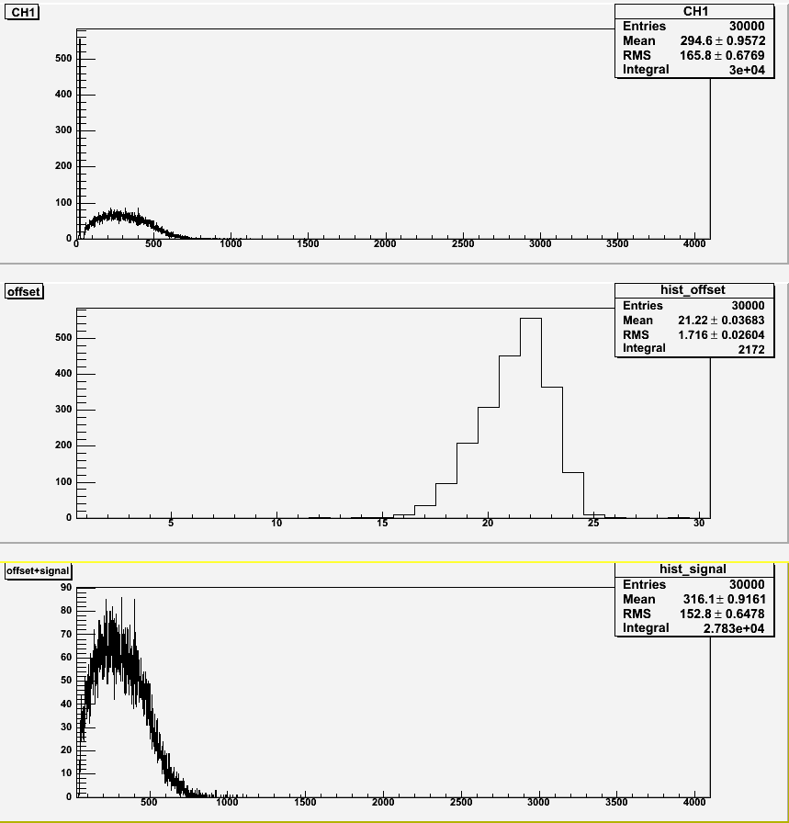
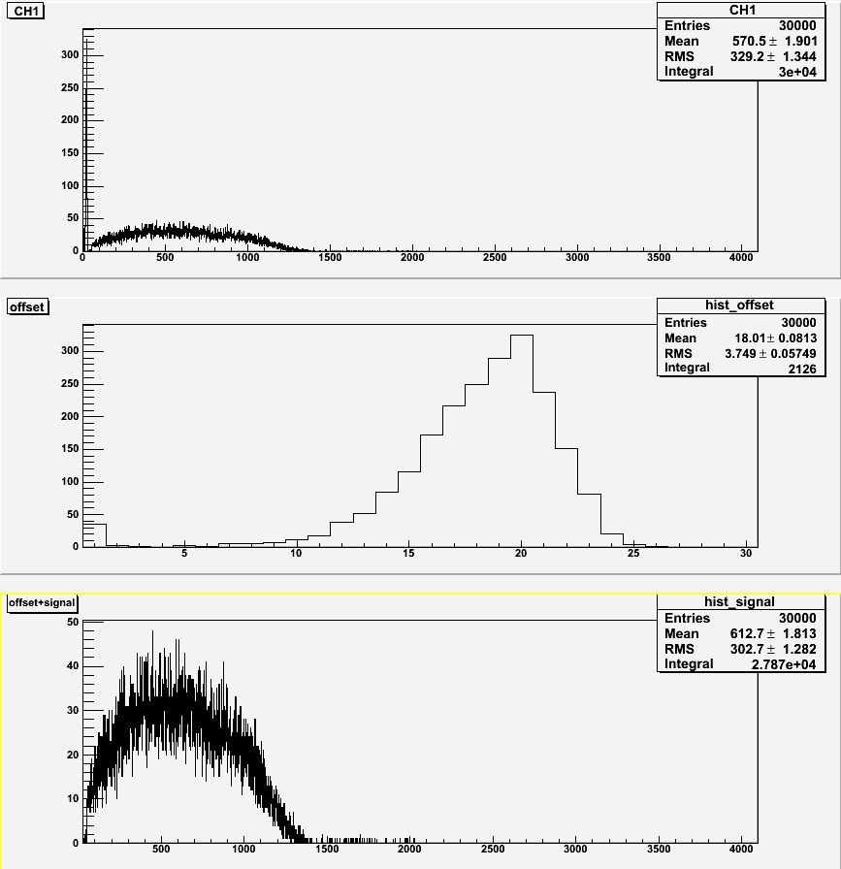
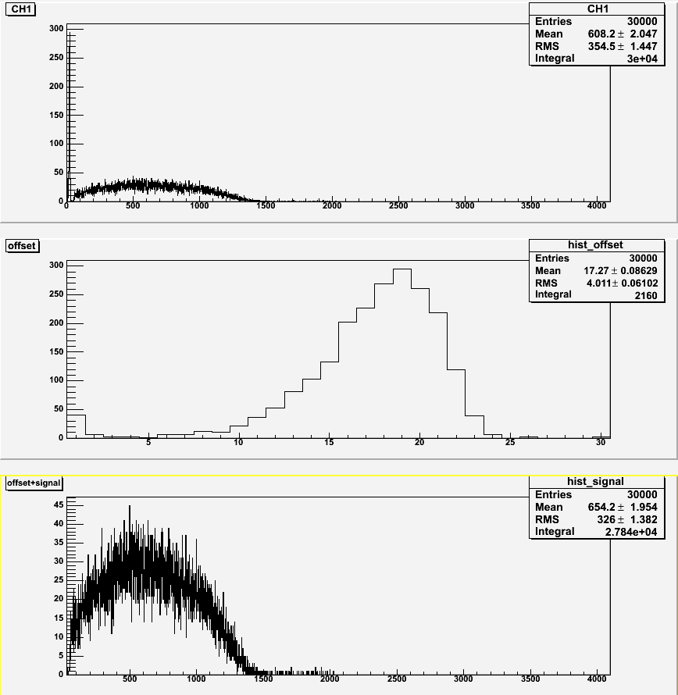
25 Gauss Transverse
No shielding
With shielding (0)
With shielding (3)

Slide 5
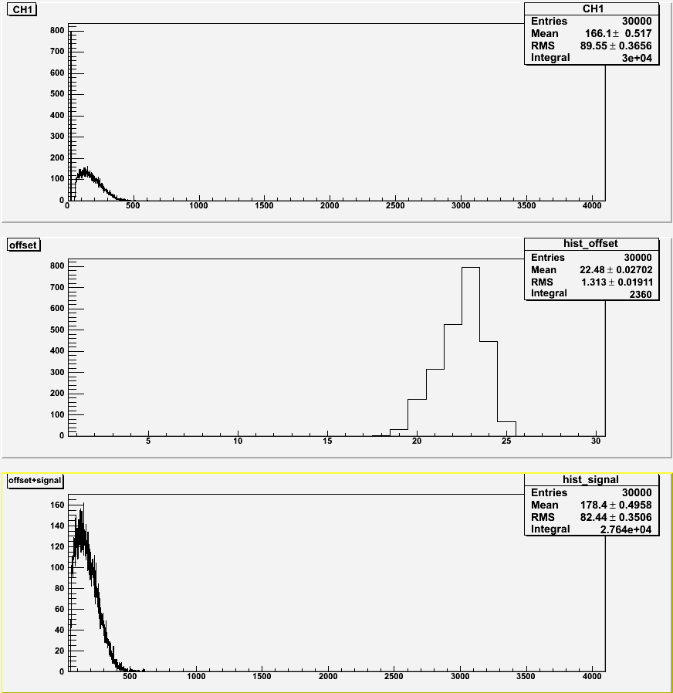
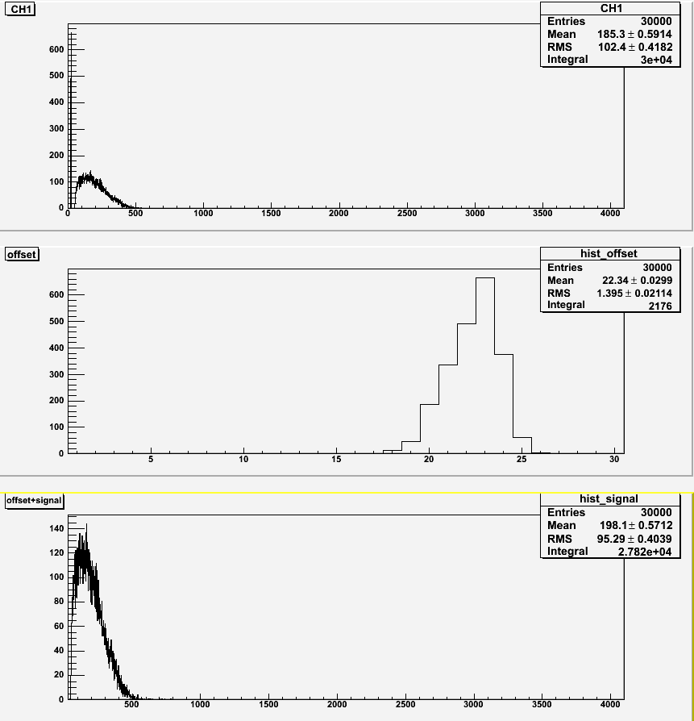
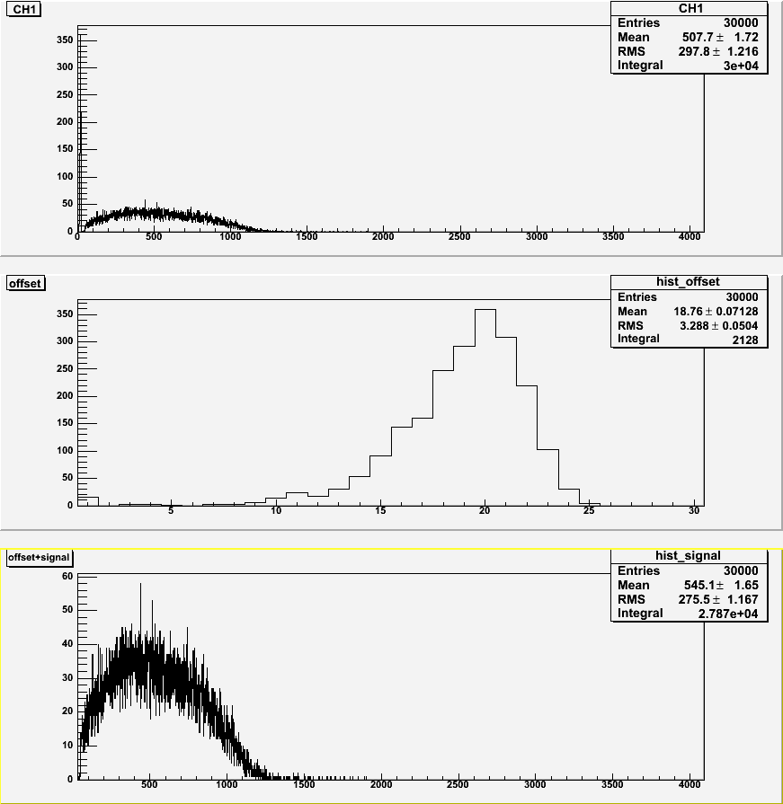
25 Gauss Axial
No shielding
With shielding (0)
With shielding (3)

Slide 6
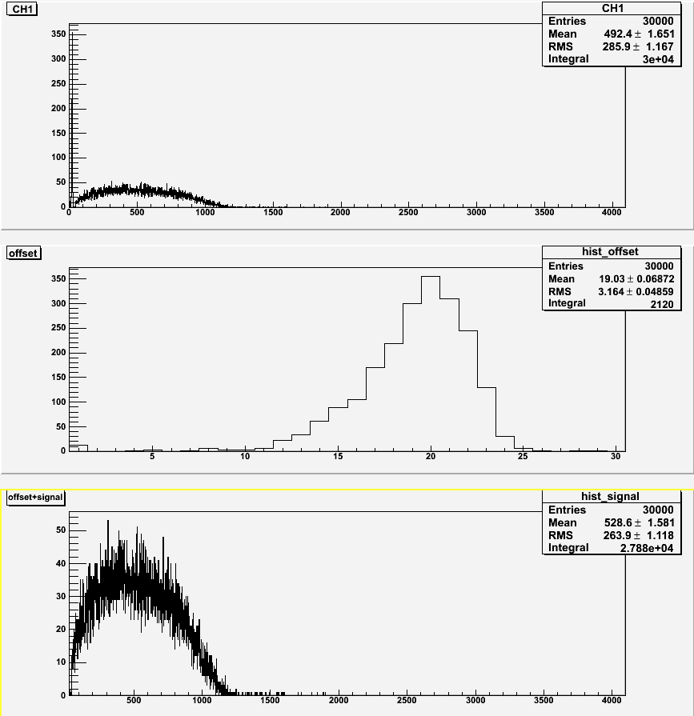
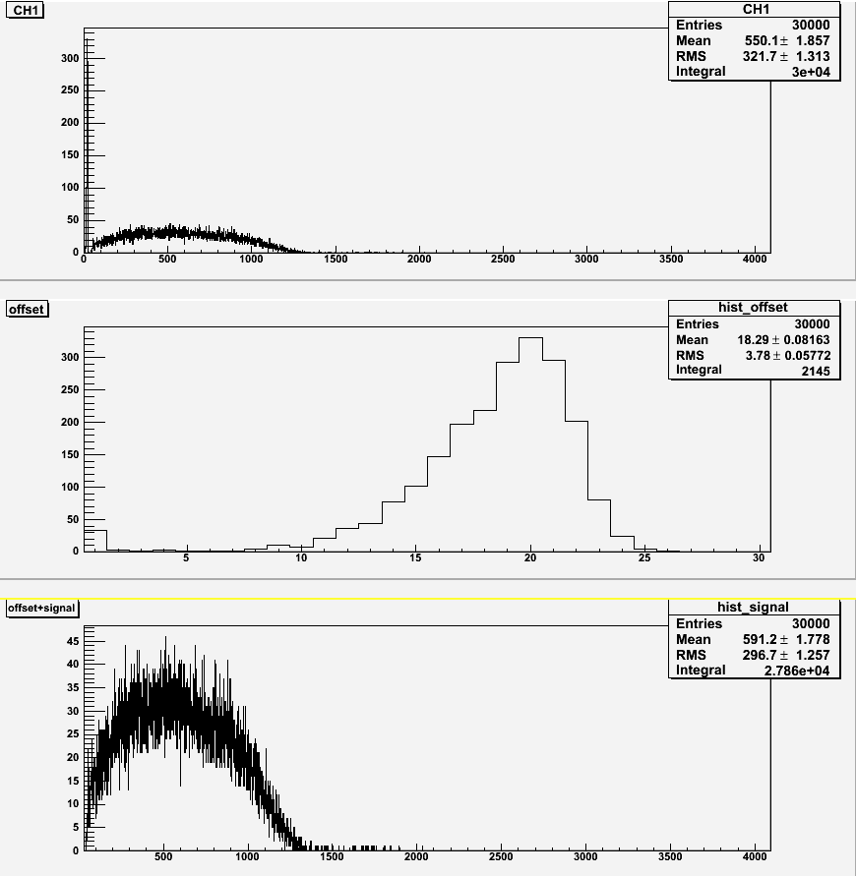
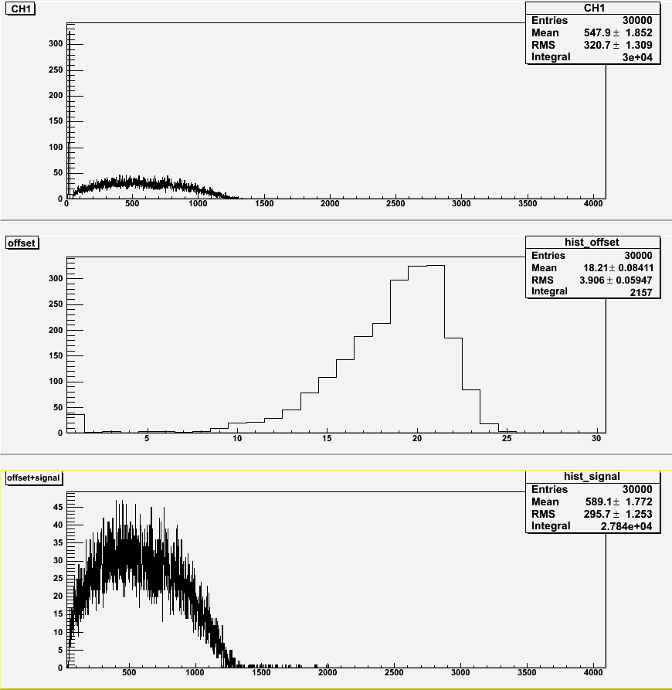
20 Gauss Transverse
No shielding
With shielding (0)
With shielding (3)

Slide 7
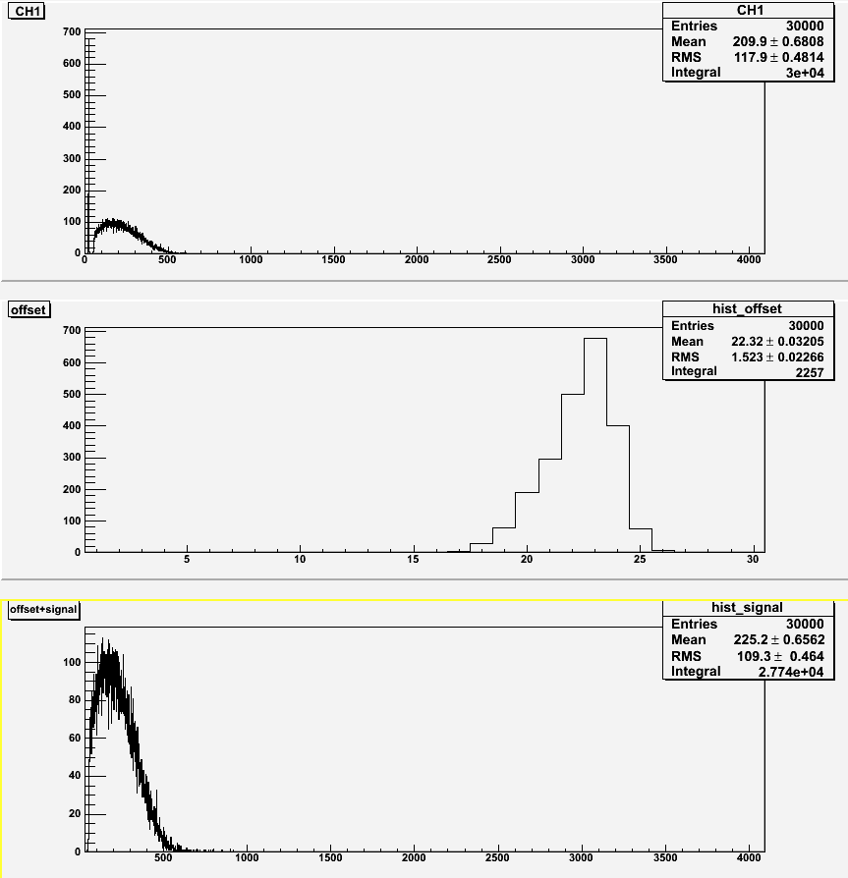
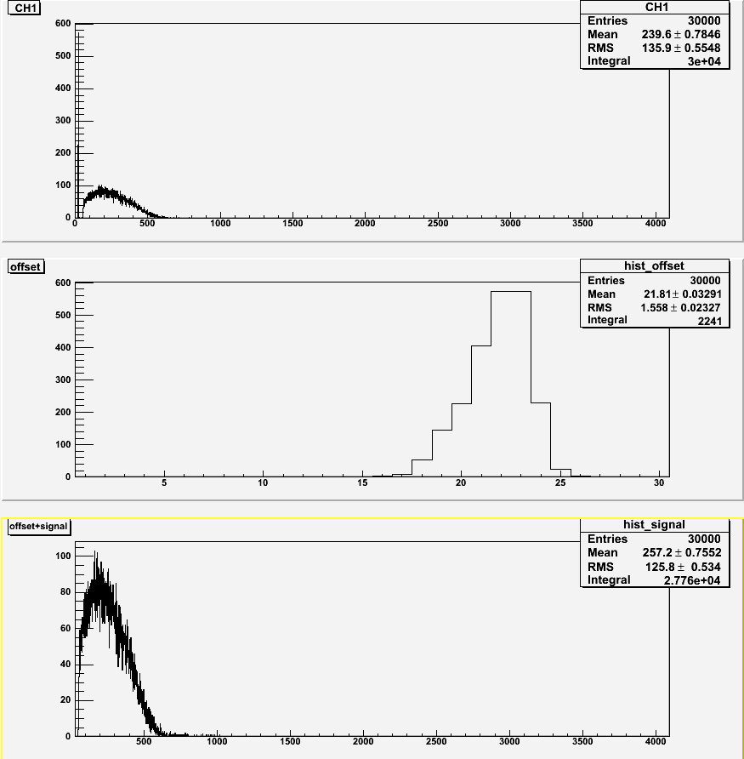
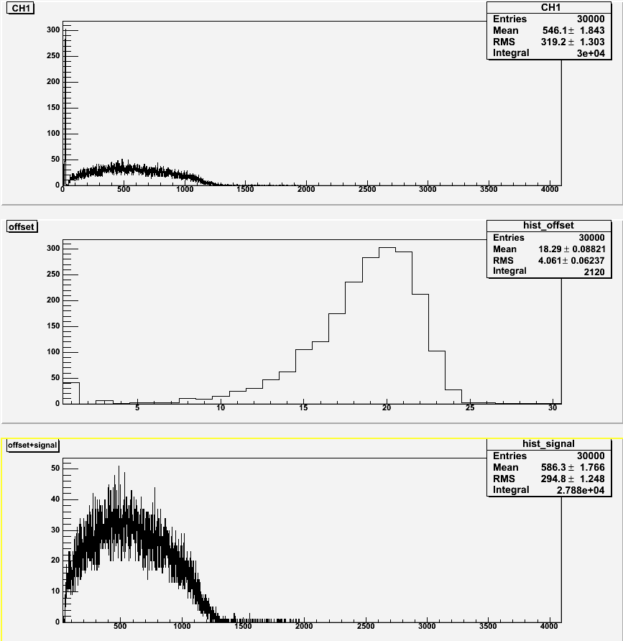
20 Gauss Axial
No shielding
With shielding (0)
With shielding (3)

Slide 8
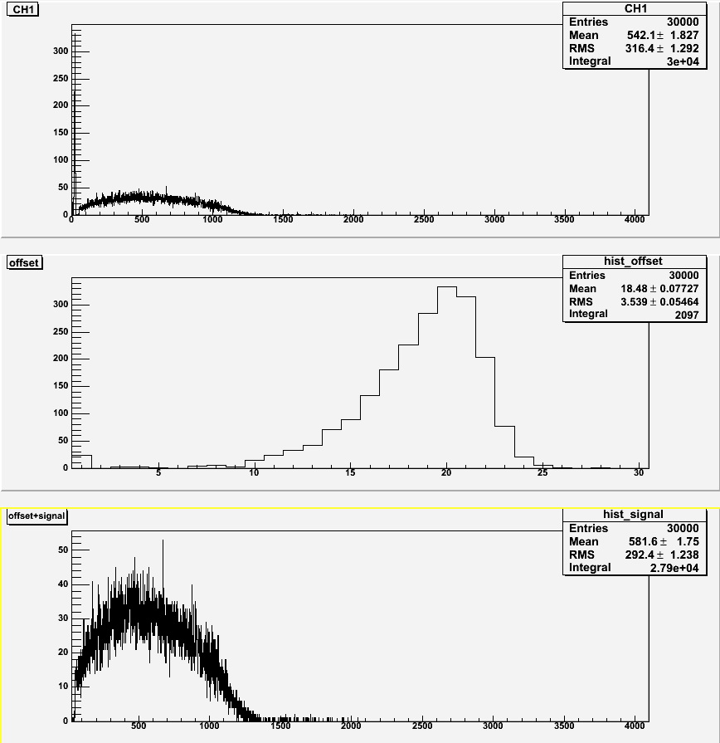
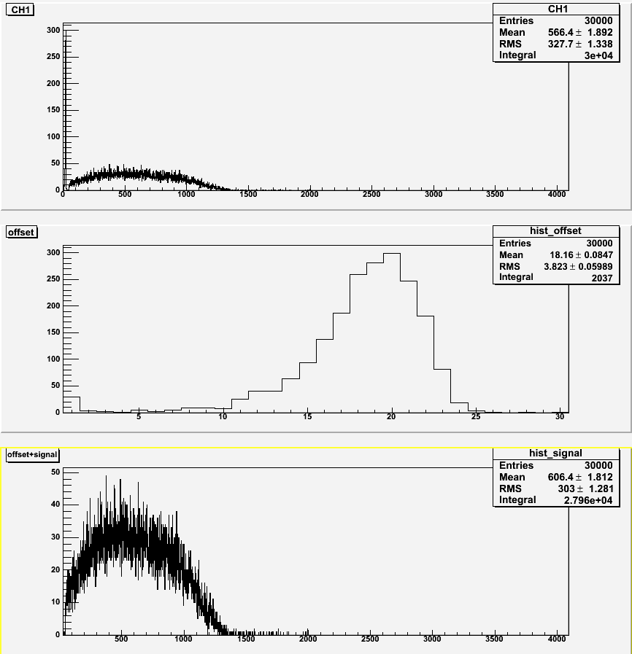
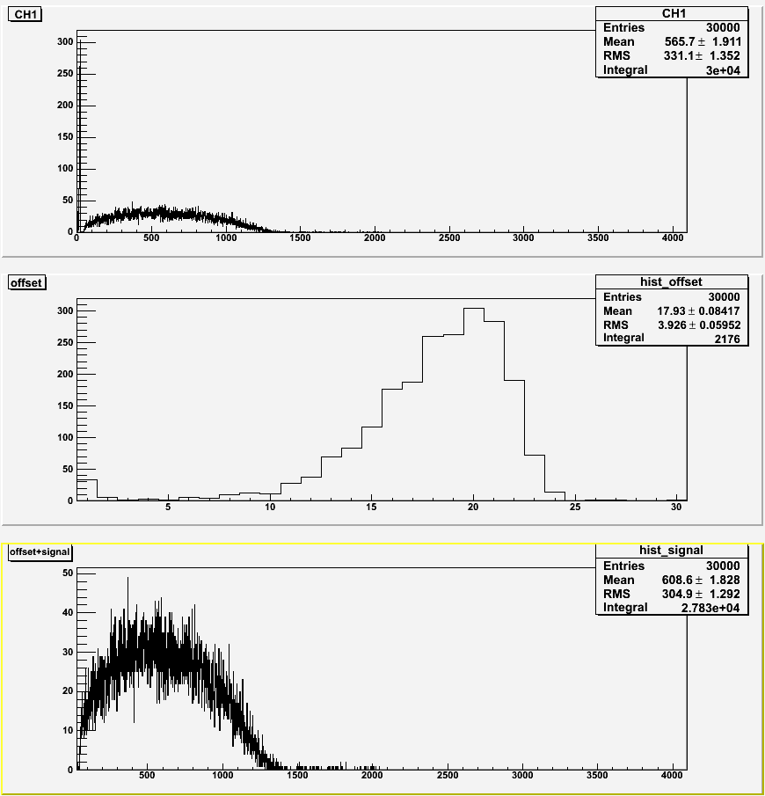
15 Gauss Transverse
No shielding
With shielding (0)
With shielding (3)

Slide 9
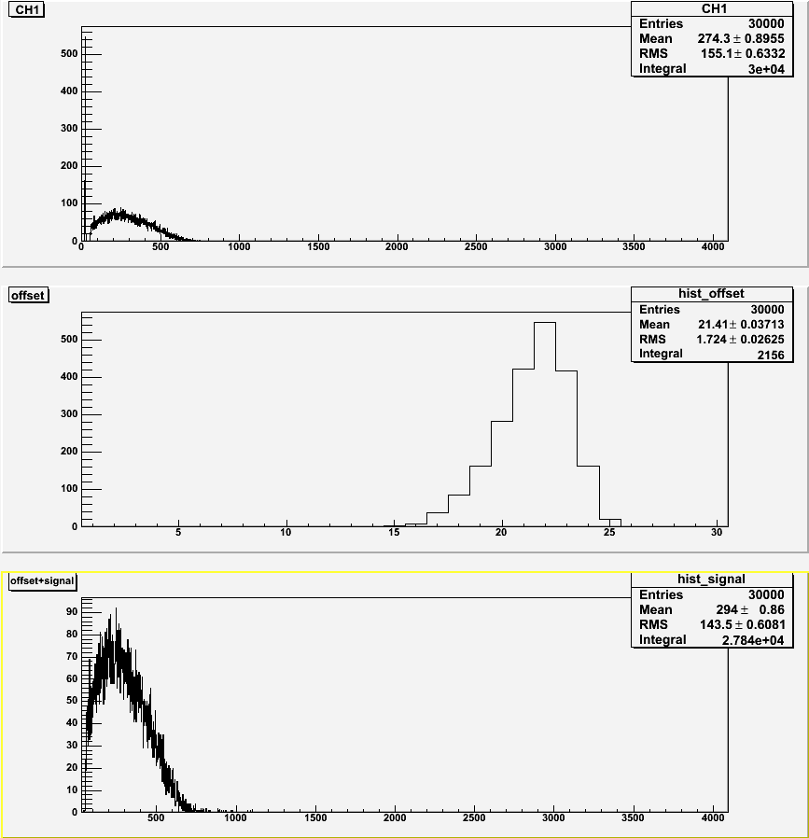
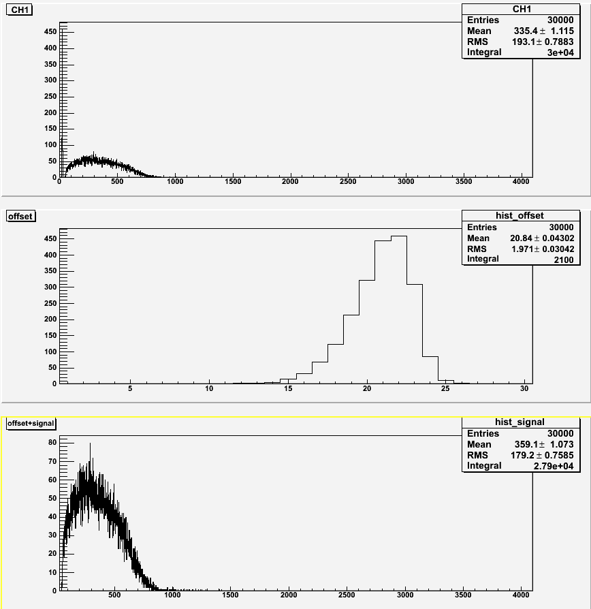
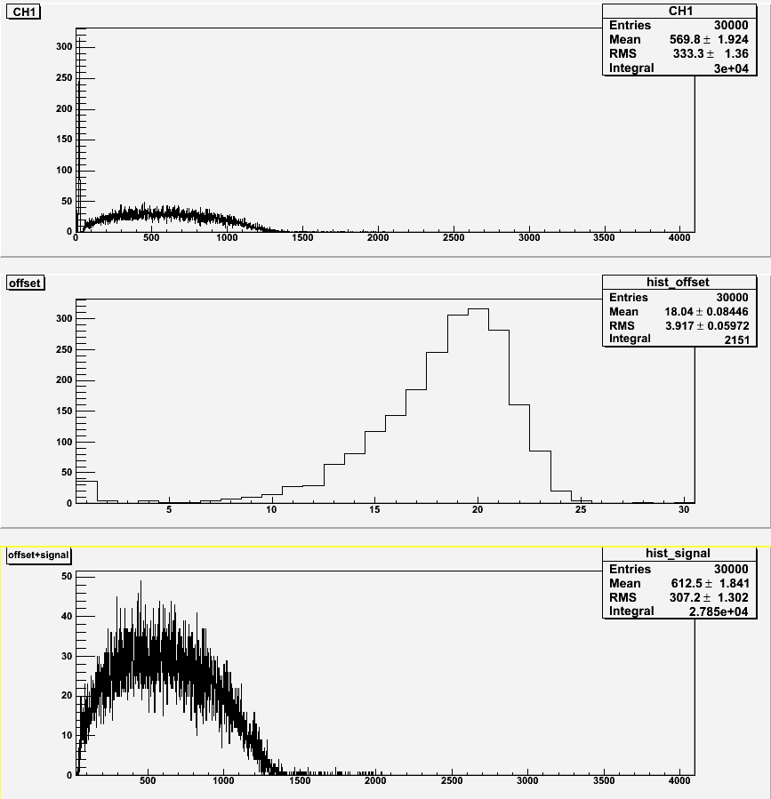
15 Gauss Axial
No shielding
With shielding (0)
With shielding (3)

Slide 10
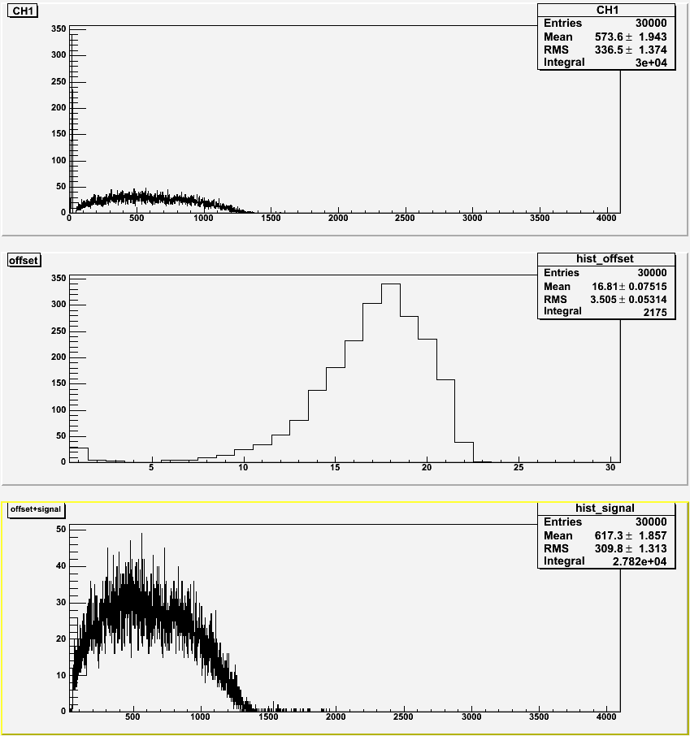
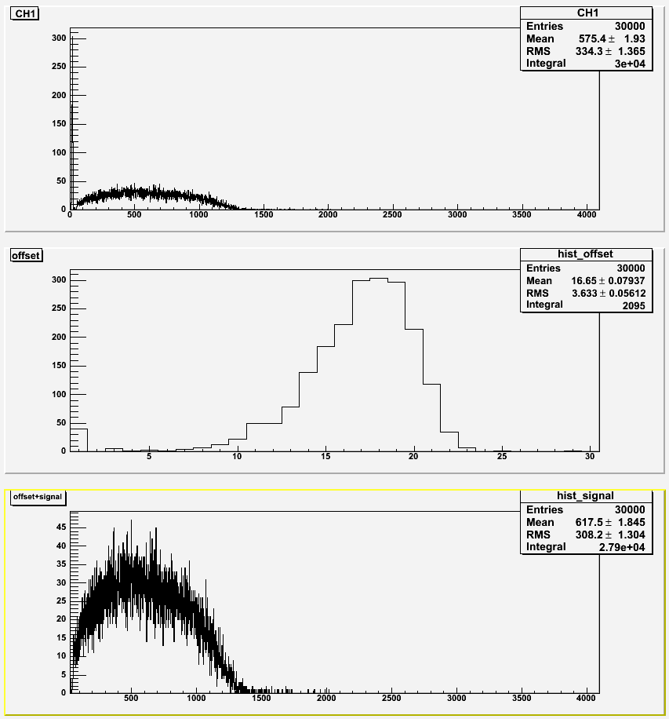
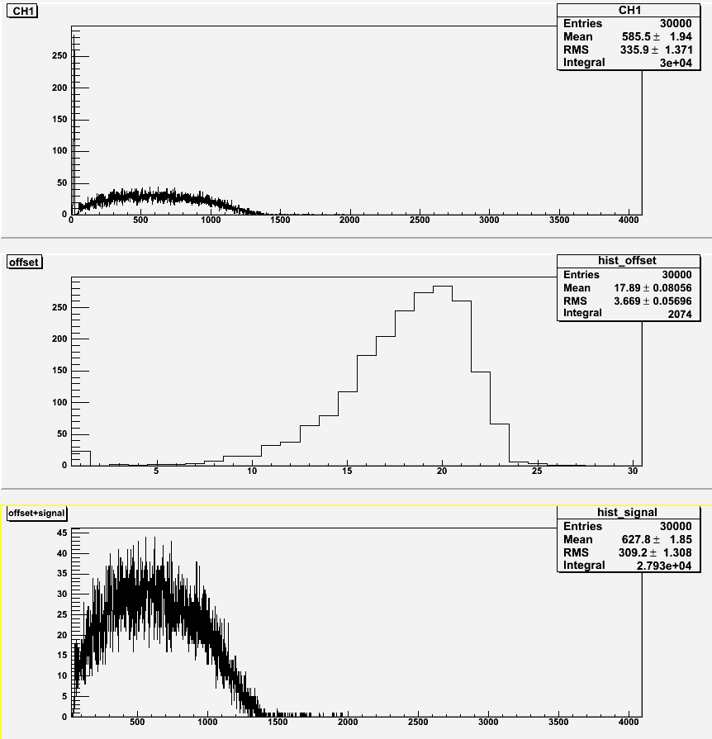
10 Gauss Transverse
No shielding
With shielding (0)
With shielding (3)

Slide 11
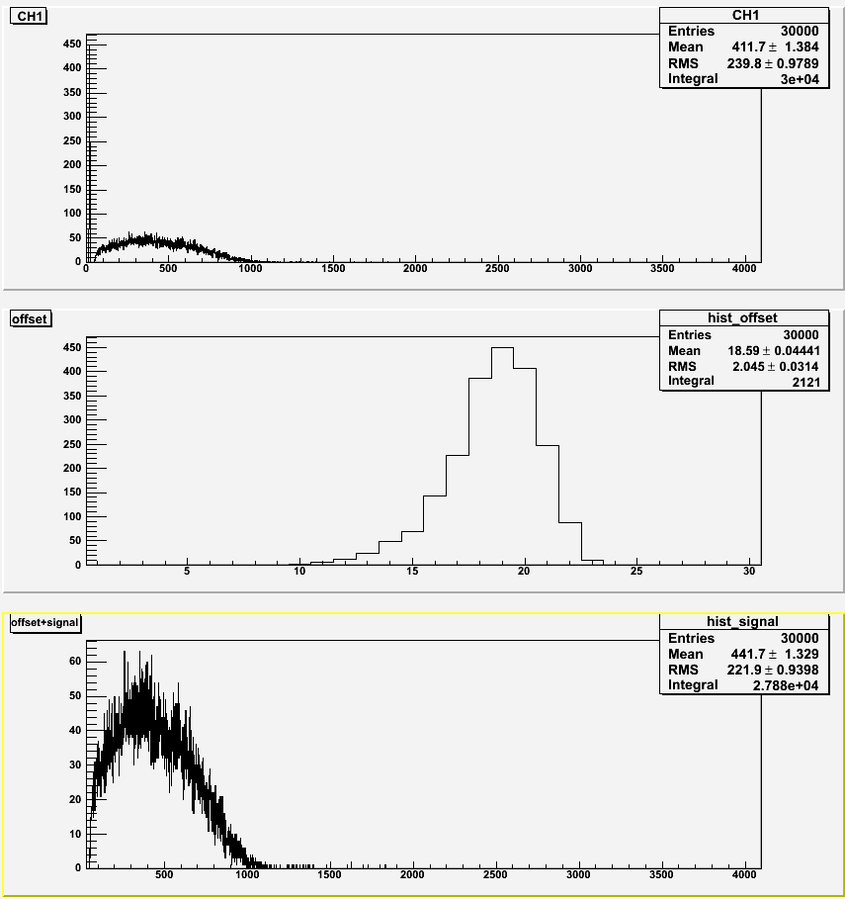

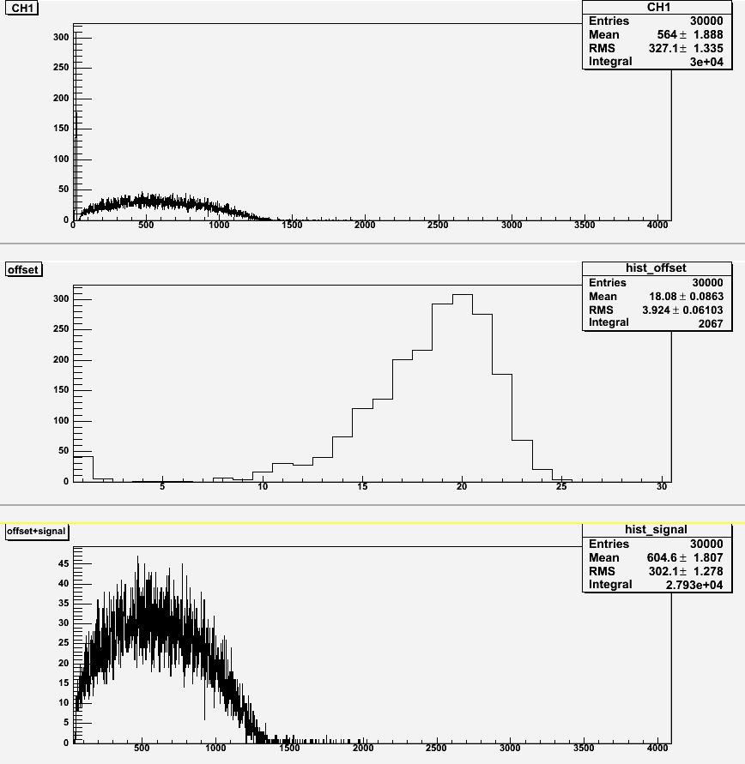
10 Gauss Axial
No shielding
With shielding (0)
With shielding (3)

Slide 12
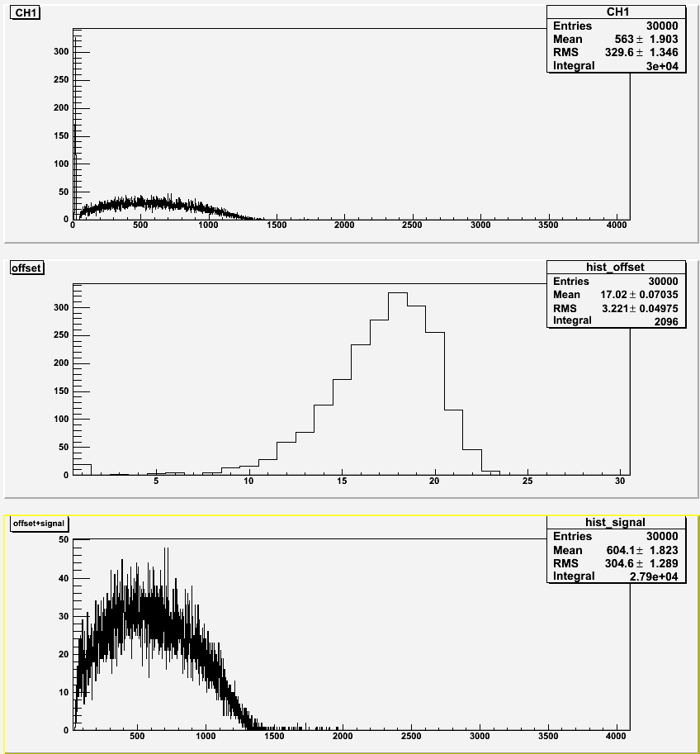
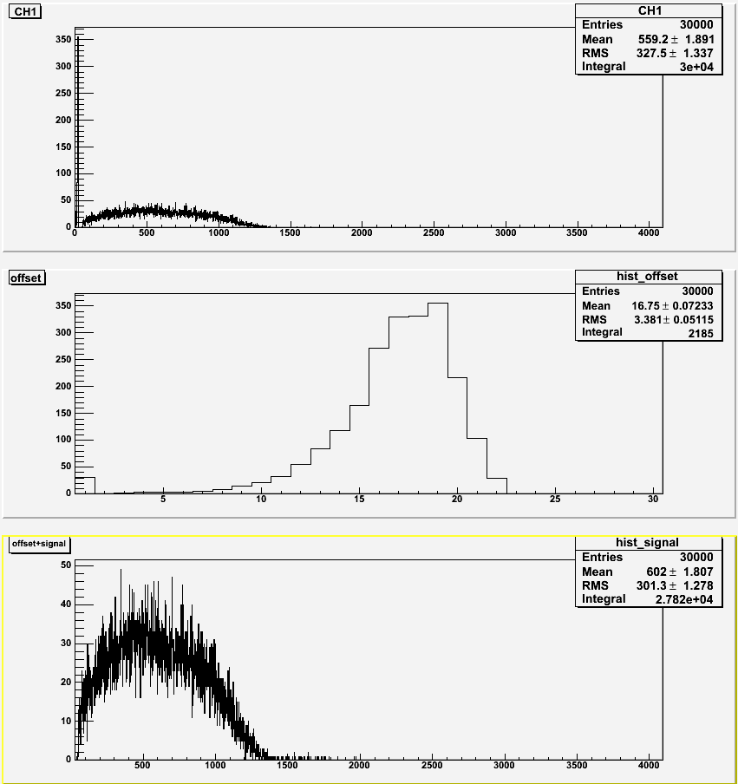

5 Gauss Transverse
No shielding
With shielding (0)
With shielding (3)

Slide 13
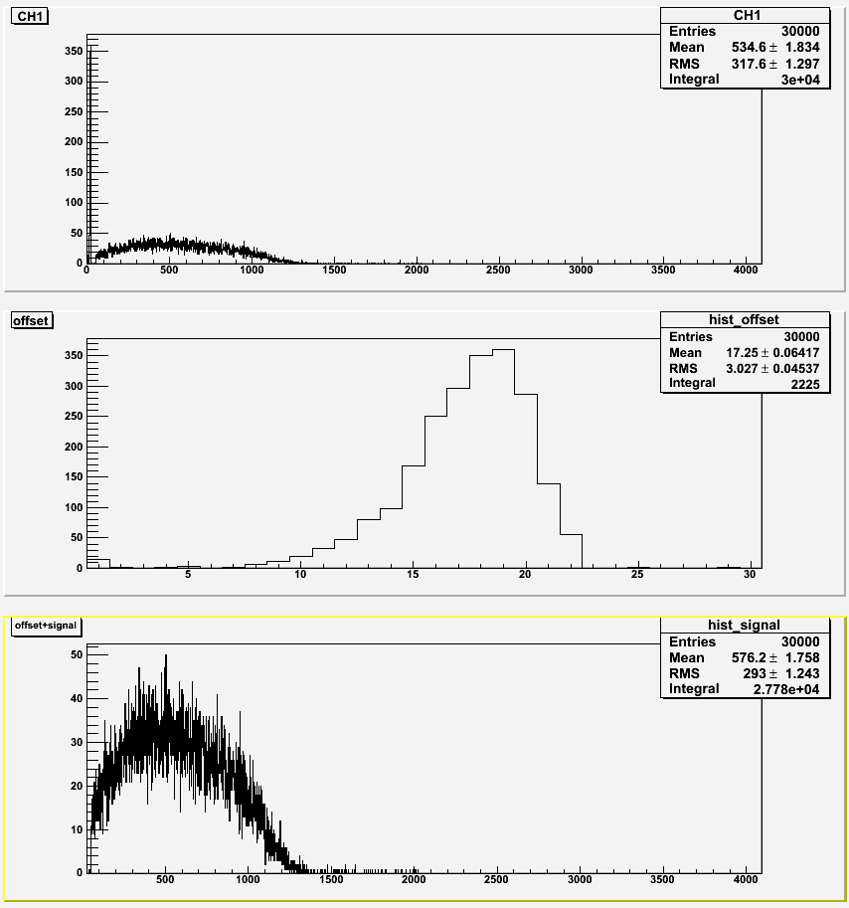
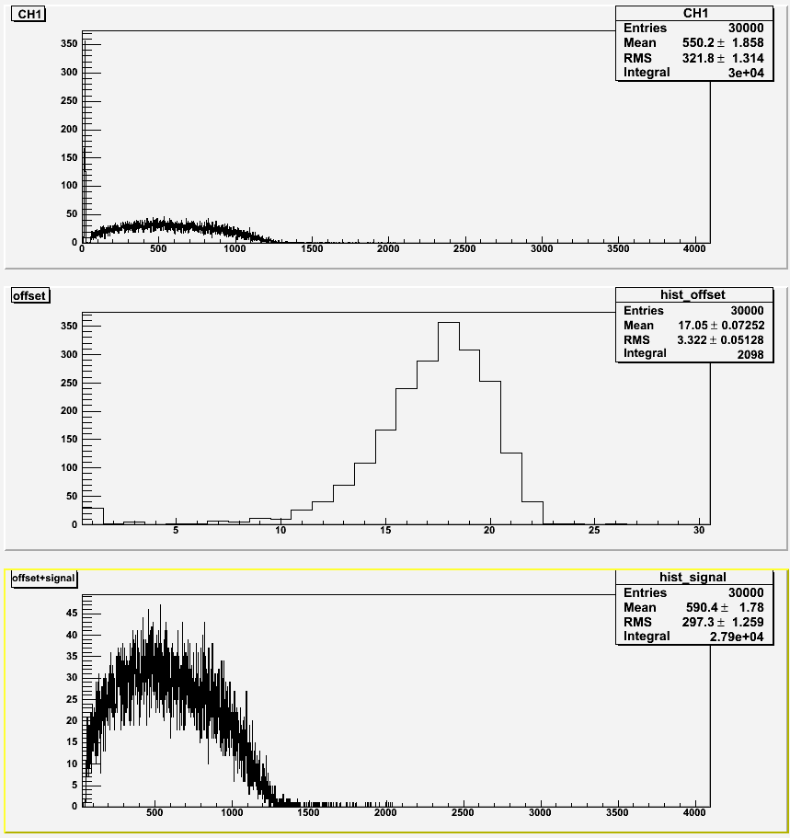
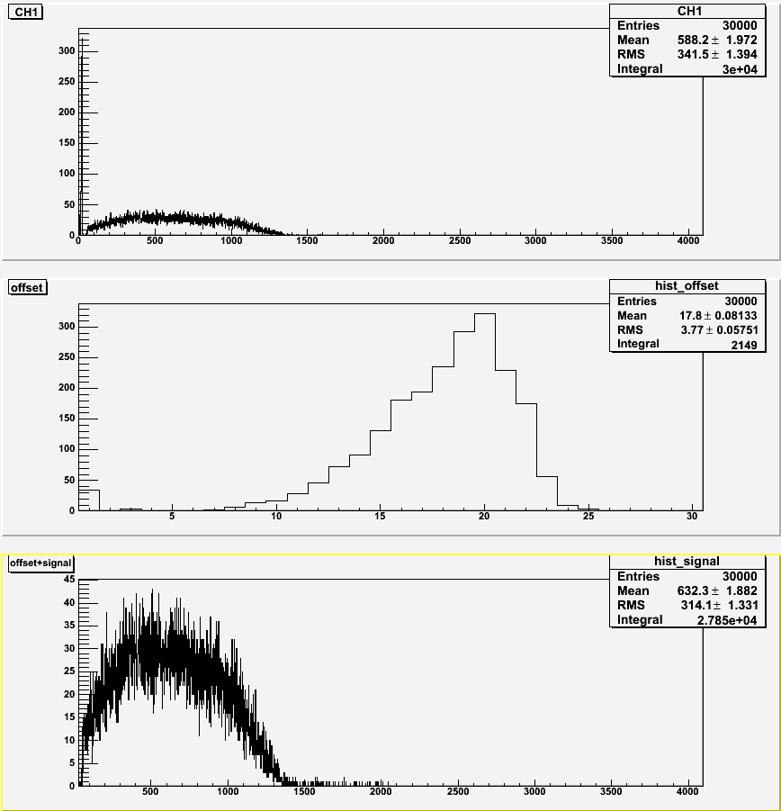
5 Gauss Axial
No shielding
With shielding (0)
With shielding (3)

Slide 14
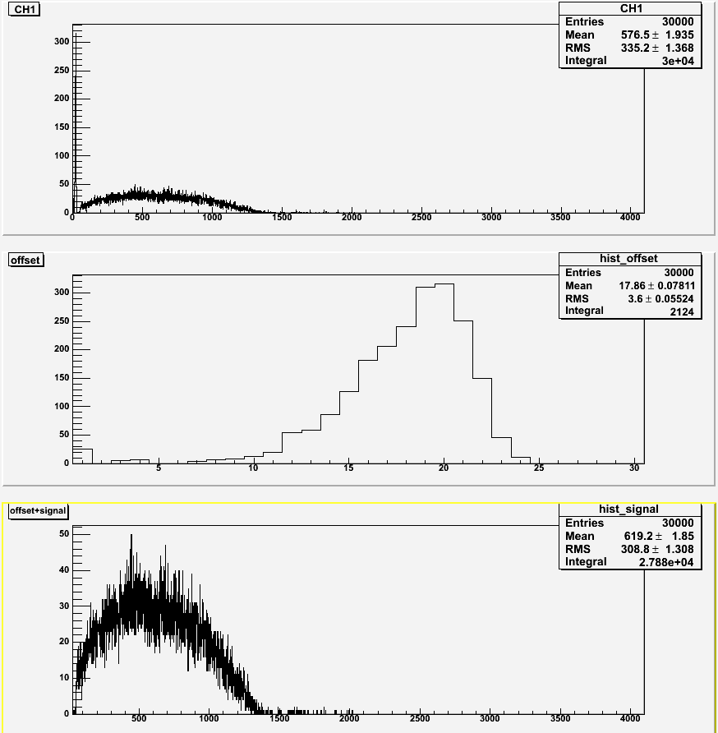
No magnetic field

